Slide 1
A Survey on Autonomic Computing Research
Abhishek J M
7019120854
ISE-JNNCE
karunadu4@gmail.com

Slide 2
A Survey on Autonomic Computing Research
Autonomic computing is a new technology to solve crisis of software complexity.
It aims to establish guidable, state-aware, and self-adaptive computer systems.
This paper covers 4 aspects on Autonomic Computing
1) An overview on concept of autonomic computing.
2) Properties of Autonomic computing and sampling
applications.
3) Important theories and technologies for autonomic
computing system models.
4) The research problems and future directions of
autonomic computing

Slide 3
A Survey on Autonomic Computing Research
The software complexity crisis
With the expansion of Internet to every corner of society and the emergence of new application models such as grid computing, pervasive computing, the size and complexity of software are increasing. This has created a situation called the software complexity crisis.
Autonomic Computing is aimed at designing and building systems that are self-managing.
By this, the system can realize self-configuration, self-optimization, self-healing and self-protection.

Slide 4
A Survey on Autonomic Computing Research
Autonomic computing is an evolution process
It can be divided into five levels
1) Basic level
2) Management level
3) Predict level
4) Adaptation level, and
5) Full autonomic level.

Slide 5
A Survey on Autonomic Computing Research
In 2001, IBM first proposed the concept of autonomic computing.
IBM pointed that complex computing systems should have four properties to achieve self-management, that is,
1. self-configuration
2. self-optimization
3. self-healing, and
4. self-protection

Slide 6
A Survey on Autonomic Computing Research
To meet self-management, systems should be designed with components that contain an autonomic manager.
IBM introduced reference model called MAPE-K which comprised of managed resources and an autonomic manager (AM)
The managed resources can be operating systems, wired or wireless network, CPU, database, servers, routers, application modules, Web service or virtual machine and so on.
Autonomic manager consists of monitoring component, analysis component, planning component, and execution component and knowledge repository.

Slide 7
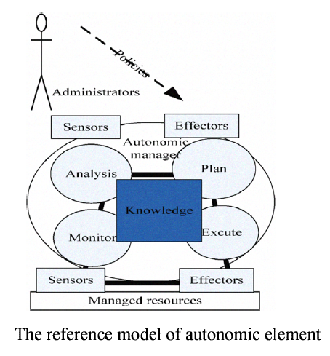
carries out autonomic decision-making and decides the adaptive goal of system
achieve the adaptive function when the system state departures from the expected goal
provides the ability of self-awareness and detects the external environment

Slide 8
A Survey on Autonomic Computing Research
The monitoring component provides the ability of self-awareness and detects the external environment.
The analysis component then carries out autonomic decision-making and decides the adaptive goal of system
planning and execution components achieve the adaptive function when the system state departures from the expected goal
The operation of four components is supported by the knowledge repository.

Slide 9
A Survey on Autonomic Computing Research
So far, the concept of autonomic computing is still in the development process, but its basic content has been clear. That is, the information system whose properties are established for reducing the workload on the system administrators, improving reliability, availability and fault tolerance of system

Slide 10
A Survey on Autonomic Computing Research
AUTONOMIC COMPUTING PROPERTIES AND APPLICATIONS
A. Self-configuration
An autonomic computing system configures itself based on the needs of the platform or a strategy provided by IT professionals to adapt to changing environment.

Slide 11
A Survey on Autonomic Computing Research
AUTONOMIC COMPUTING PROPERTIES AND APPLICATIONS
B. Self-healing
An autonomic computing system detects, diagnoses abnormalities and makes the appropriate repair measures. Self-healing component can detect system failure and in the case of uninterrupted service, it initiates repair measures automatically based on pre-specified strategy by IT professionals.

Slide 12
A Survey on Autonomic Computing Research
AUTONOMIC COMPUTING PROPERTIES AND APPLICATIONS
C. Self-protection
An autonomic computing system predicts, identifies and prevents the threat which is from anywhere. Self-protection component can detect hostile acts and take appropriate measures to ensure stability of the system.

Slide 13
A Survey on Autonomic Computing Research
AUTONOMIC COMPUTING PROPERTIES AND APPLICATIONS
D. Self-optimization
An autonomic computing system automatically optimizes managed resources, and the optimization component adjusts itself to meet the needs of their end-user and business needs

Slide 14
A Survey on Autonomic Computing Research
THEORIES AND TECHNOLOGIES
Autonomic computing system involves service-oriented technology, Agent technology, adaptive control theory, machine learning, and optimization theory and so on

Slide 15
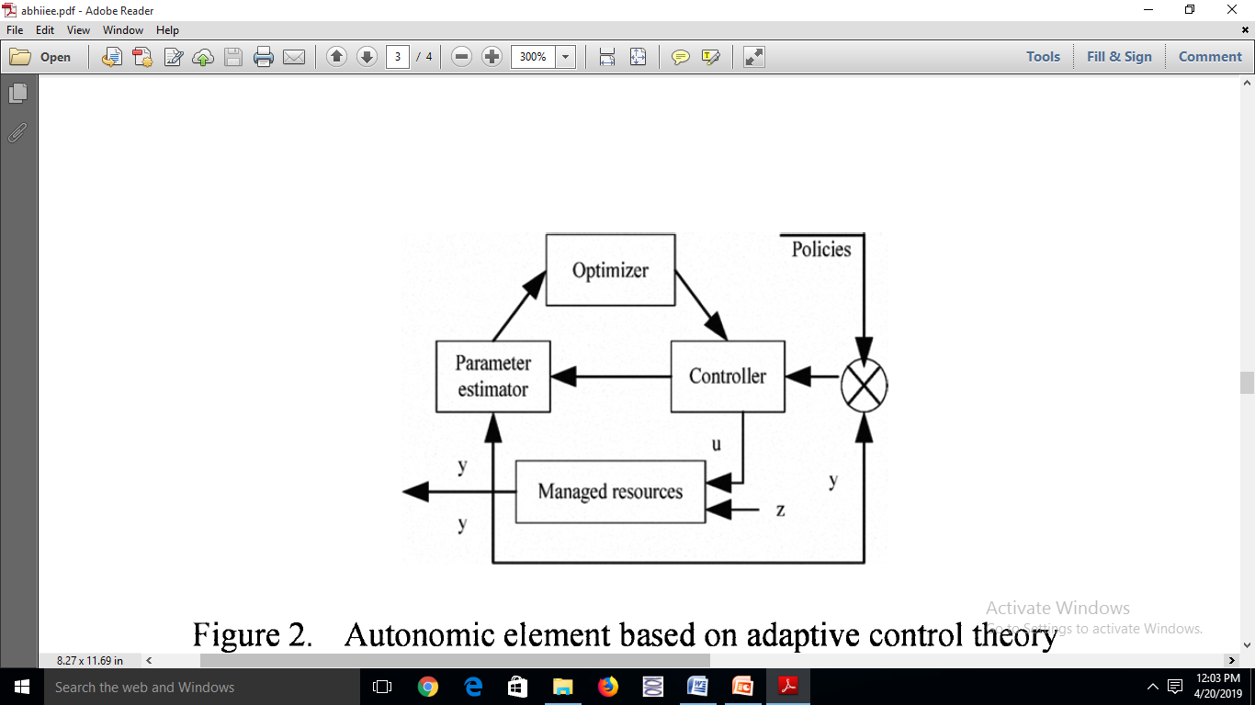
A Survey on Autonomic Computing Research
Adaptive Control Theory
Here, Adaptive Control System measures the input /output information, obtains the dynamic characteristics of the managed object and systematic errors in time and makes decisions and modifies the controller parameters autonomously to adapt control signal to meet the changes of object and disturbance, to maintain optimal control performance of system.
Autonomic Element Based on Adaptive Control Theory

Slide 16
A Survey on Autonomic Computing Research
B. Agent Technology
Agent called intelligent agent has the properties of reactivity, autonomy and social. It can sense the environment to make a reaction (Reaction Agent) or to achieve the goal-oriented behavior (Deliberative Agent) by plan
Also, agent has been widely known as the key technology which supports the large-scale, open and distributed information systems to achieve dynamic service integration and teamwork

Slide 17
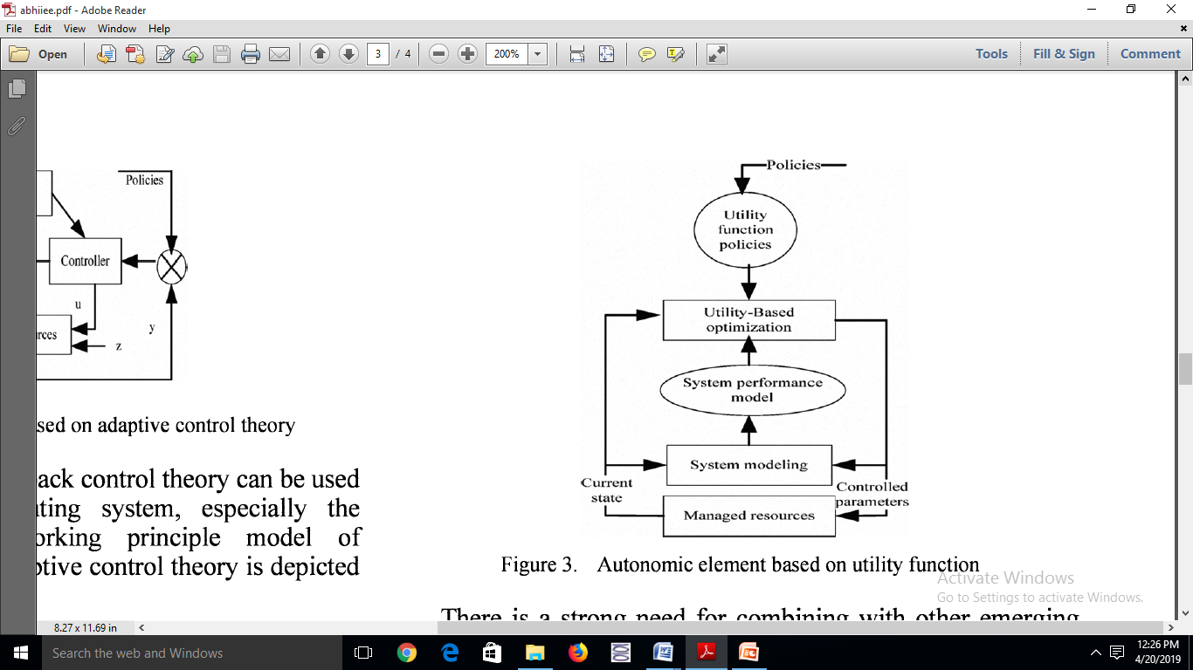
A Survey on Autonomic Computing Research
C. Utility Function
Utility is one of the most commonly used concepts in economics. In autonomic computing, utility function maps each possible state (system performance) of the entity (autonomic element) to a real number, for showing the value which corresponds to system performance (such as reaction time, delay, throughput, etc.).

Slide 18
A Survey on Autonomic Computing Research
AUTONOMIC COMPUTING RESEARCH PROBLEMS
AND FUTURE DIRECTIONS
At present, some problems of autonomic computing have been studied at home and abroad. However, the research of theory, method and techniques on this new computing model is far from being systematically carried out. There are many problems that have not yet discovered and have to be resolved.
Some of the problems are as follows :
Autonomic Computing System Architecture
B. Software Engineering Tools for Autonomic Computing System
C. Strategies for Autonomic Computing

Slide 19
A Survey on Autonomic Computing Research
CONCLUSIONS
With the promotion of researchers and practitioners, autonomic computing research has infiltrated into pervasive computing, grid computing, software architecture and other fields. It has achieved fruitful research results. However, it remains a relatively immature topic. In this paper, an introduction to autonomic computing is presented, and point out that the current research problems and research prospects hoping to provide a useful reference for the further study of autonomic computing.

Slide 20
A Survey on Autonomic Computing Research
THANK YOU
Abhishek J M
7019120854
ISE-JNNCE
karunadu4@gmail.com

